Slide 1
Keeping State
Have you been putting off learning Redux?
Better state than never! #BadPun
Notes:
Introduction:
Gage the room.
-How many people have used Angular2? Firebase? AWS S3?
-

Slide 2






Scott Wittrock
Raleigh ← Brooklyn ← Minneapolis
Current Employment
Triangle Dev - triangledevs.slack.com
Triangle Product - triproduct.slack.com
scott@dolist.io
@fixitinpost42
Notes:
I’ve been a Product Manger for 5 years.
I’ve been a front end developer for the last two years.
I work at Zift Solutions during the day, but at night I’m working on a productivity app called Dolist.
I’ve worked at

Slide 3
Coding Background
HTML/CSS
Javascript
AngularJS
Front-End
Angular 2/4
Ionic 2
Redux (ng-rx)
Node.JS
Back-End
Python
Python
Python
4 Years Ago
Today

Slide 4
Open Roles @
Product Owner
.NET Developer
Scott.wittrock@ipreo.com
For more info: ipreo.com/careers

Slide 5
Mobile Stack
Angular 4
Front-End
Ionic
Cordova
Mobile Services (C#/.NET)
Back-End
Core Services

Slide 6
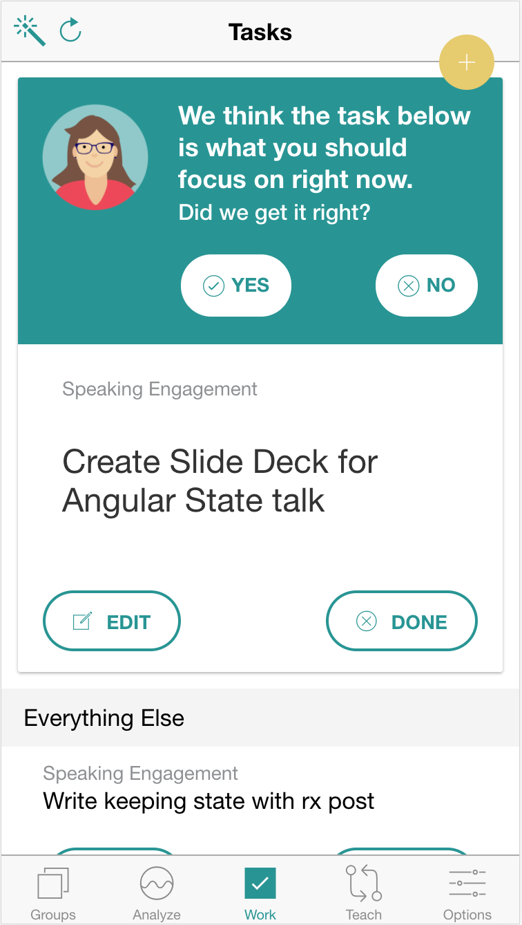
The task list that:
Learns your habits over time
Suggests the right task at the right moment
One list for every aspect of life
Download: http://bit.ly/dolist-io
Notes:
Just a quick plug for Dolist.

Slide 7
State
S
Any data that is stored that can change in an app.

Slide 8
Types of State
Data from Database
UI Elements
Form Data
Error States
URL State

Slide 9
Levels of Complexity in State
Simple
Storing State in Component
Data Down/Events Up
State in a Service
State Management Library
Complex

Slide 10
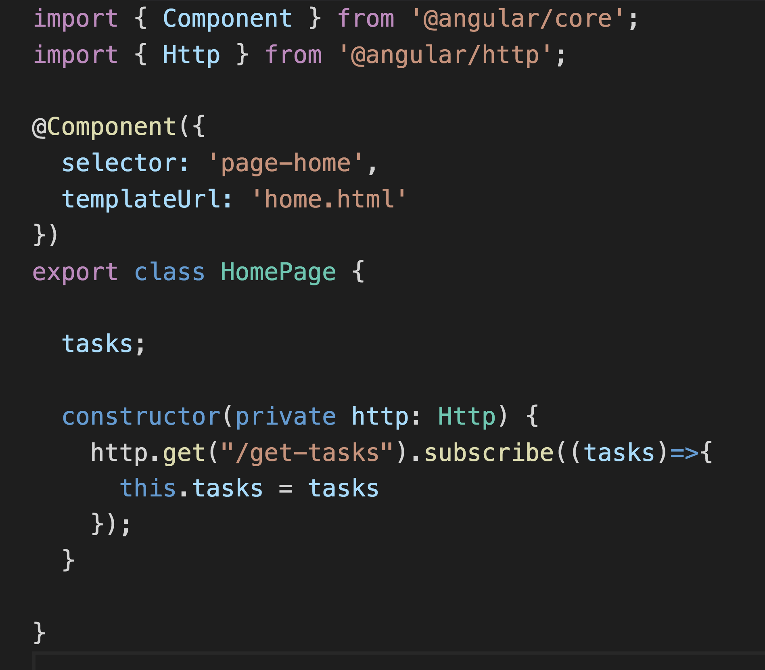
The Simplest App
HomePage (Component)
State

Slide 11
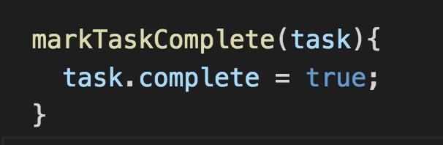
The Problem: Sibling Components
HomePage
TaskDetailsPage
ArchivePage
State
State
State

Slide 12
Data Down/Events Up
AppComponent
State
@Input
@Input
Events
Events
@Input
HomePage
Events
ArchivePage
TaskDetailsPage
State
State
State

Slide 13
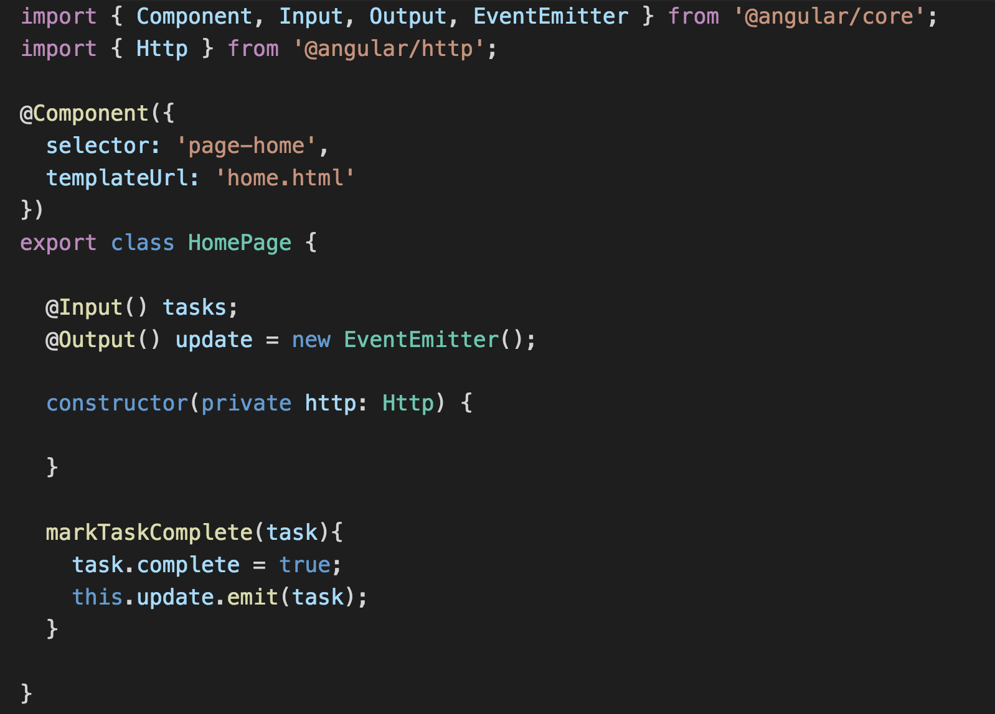
Data Down/Events Up
State in Component

Slide 14
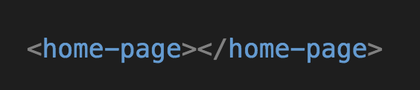
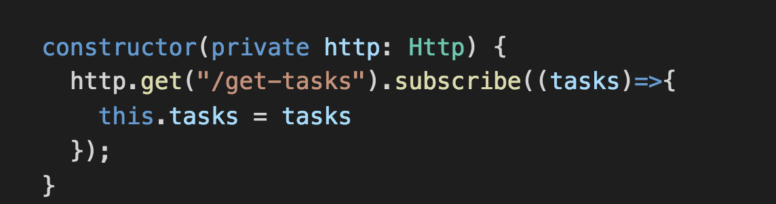
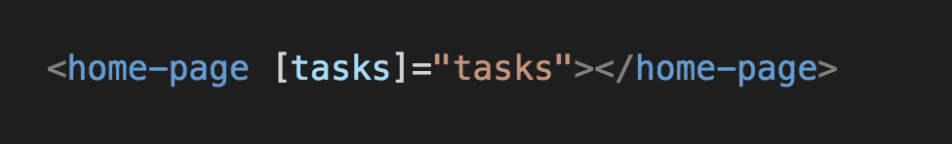
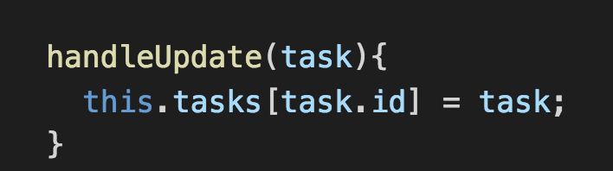
Higher Level Component
Component Handles the State
Add the @Input
Catch the Event
Handle the Event

Slide 15
Data Down/Events Up
AppComponent
State
@Input
@Input
Events
Events
@Input
HomePage
Events
ArchivePage
TaskDetailsPage
State
State
State

Slide 16
Put It In A Service!
TaskDataService
AppComponent
State
State
HomePage
ArchivePage
TaskDetailsPage
State
State
State

Slide 17
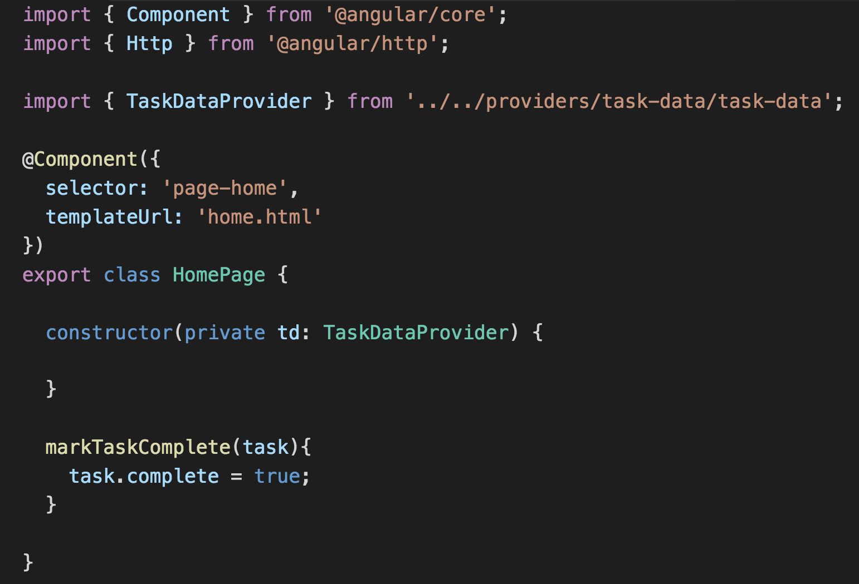
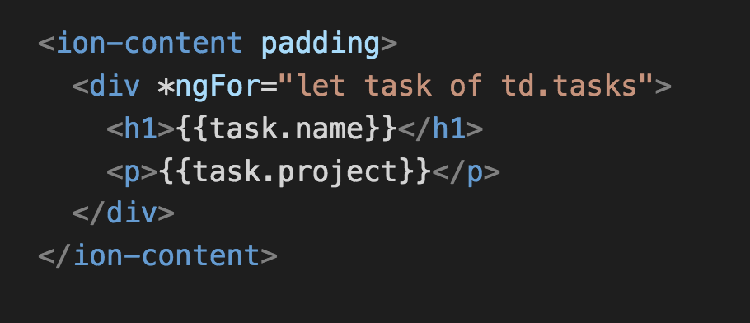
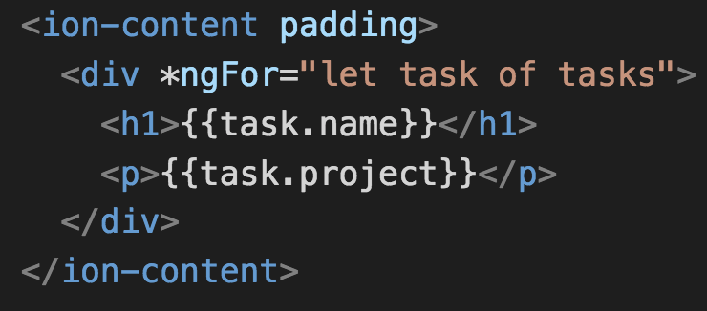
Data Down/Events Up
State in a Service

Slide 18
Put It In A Service!
TaskDataService
AppComponent
State
State
HomePage
ArchivePage
TaskDetailsPage
State
State
State

Slide 19
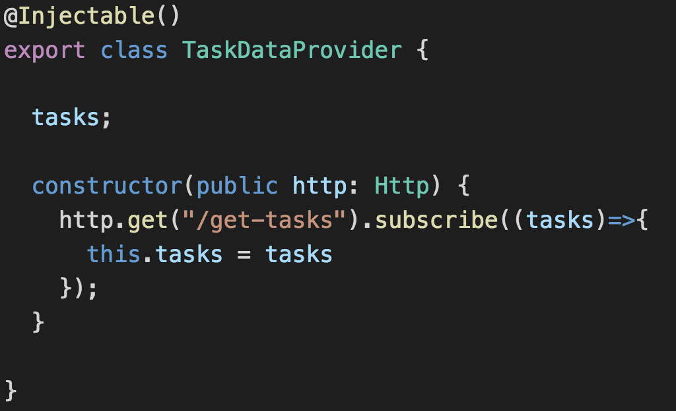
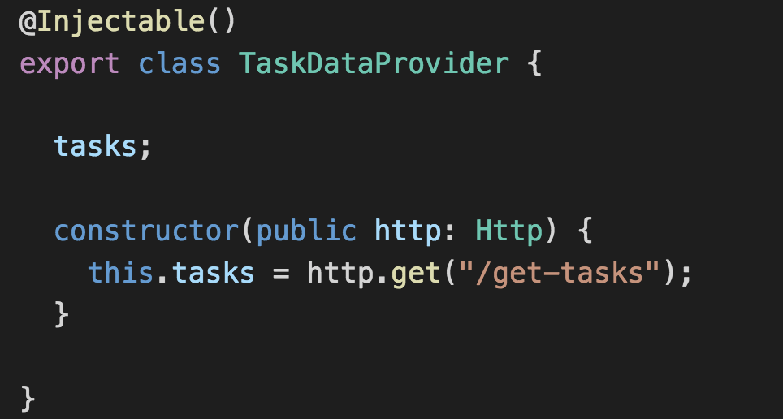
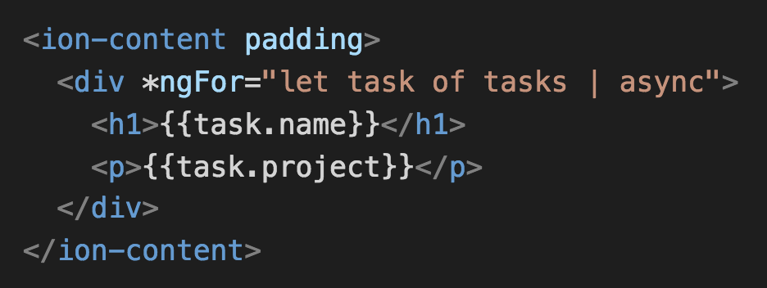
State in a Service
State in a Service With Observables

Slide 20
Put It In A Service!
TaskDataService
AppComponent
State
State
HomePage
ArchivePage
TaskDetailsPage
State
State
State

Slide 21
Ok this seems complex and kind of sucks…

Slide 22
Somebody must have solved this problem already!

Slide 23
They did!

Slide 24
Enter Redux!

Slide 25
Redux
R
Redux is a predictable state container for JavaScript apps.
http://redux.js.org

Slide 26
The Parts of Redux
S
Store
Immutable way to store application state in a single JavaScript object.
A
Actions
Payloads of information that send data from your application to your store. Actions define what happened, but not how the state will change.
R
Reducers
Pure function that specifies how the state changes in response to an action.
E
Effects
A way to handle side effects, and async calls.

Slide 27
How they work together
A
S
R
New State
SUCCESS or FAILURE
E
Server Data

Slide 28
Pick Your Library
NgRx/Store
angular-redux

Slide 29
ngrx
Using ngrx/store
Action
Effects
Reducer
AppComponent
Store
State
HomePage
State
TaskDetailsPage
ArchivePage
State
State

Slide 30
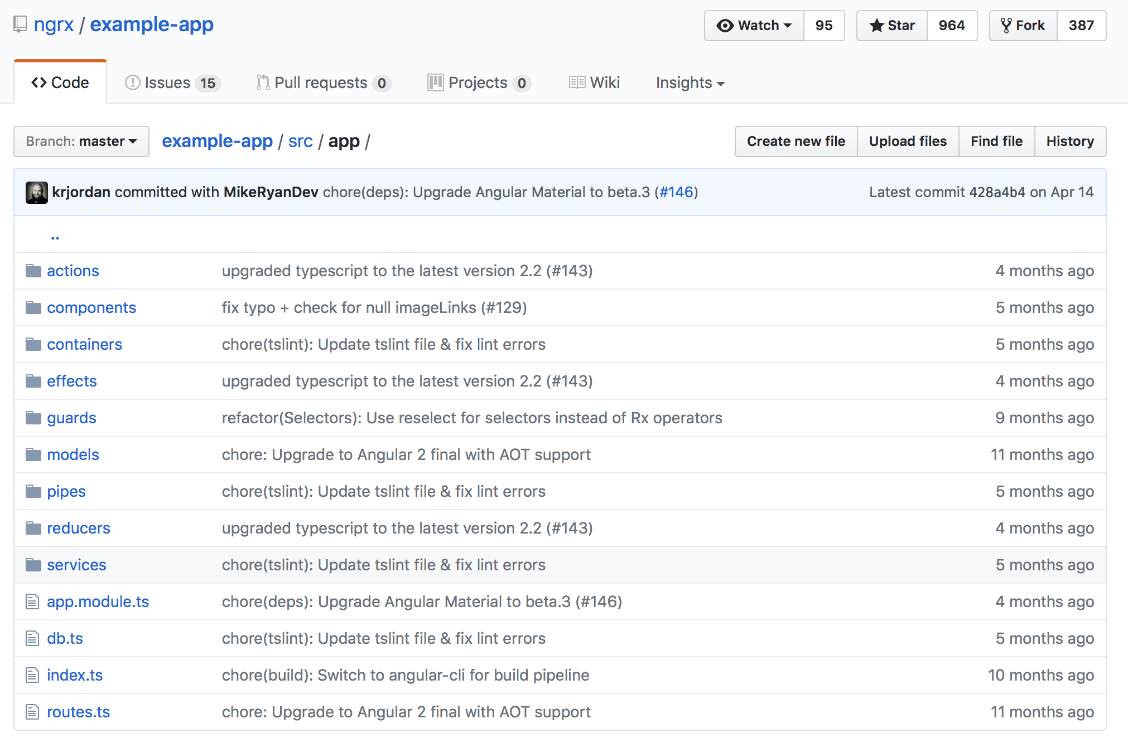
https://github.com/ngrx/example-app/tree/master/src/app

Slide 31
Connect
scott@dolist.io
@fixitinpost42
@dolist_io
Triangle Dev - triangledevs.slack.com
Triangle Product - triproduct.slack.com
Download Dolist
http://bit.ly/dolist-io
Jobs!
scott.wittrock@ipreo.com

